Slide 1

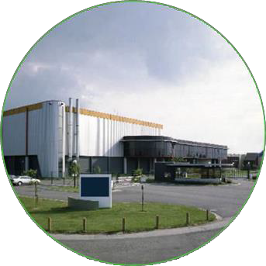


BelGaN launches
GaN-ValleyTM membership program
at CS International
The BelGaN Innovation Factory & GaN ValleyTM: “Building a Wide Bandgap Semiconductor Innovation Ecosystem in Europe”
Dr. Marnix Tack – CTO BelGaN
Confidential

Slide 2
OUTLINE
Setting the stage ➔ GaN bringing a paradigm shift in power electronics
BelGaN intro ➔ A new Open Foundry for WBG semiconductors in Europe
BelGaN Innovation Factory ➔ Bring leading WBG innovation to market
GaN-ValleyTM ➔ BelGaN launches GaN-ValleyTM membership program

Slide 3

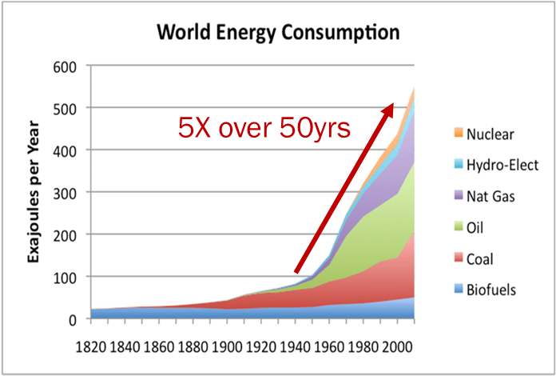
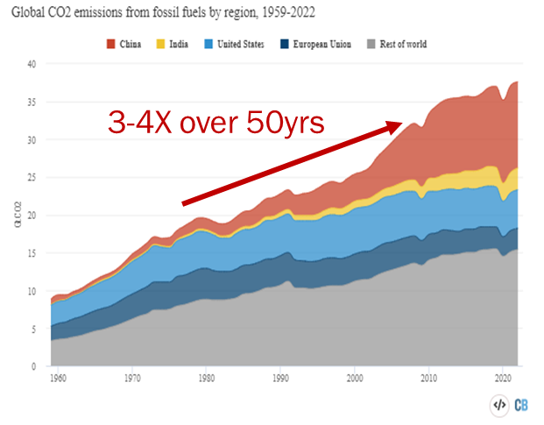
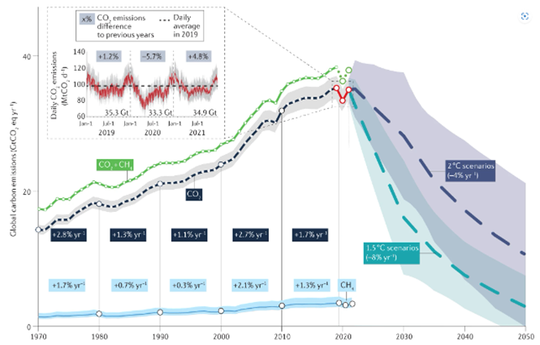
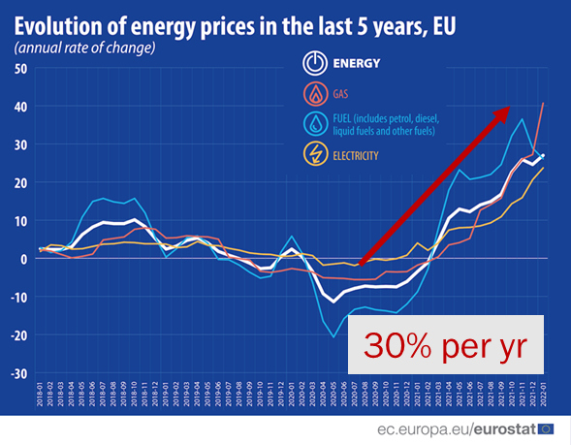
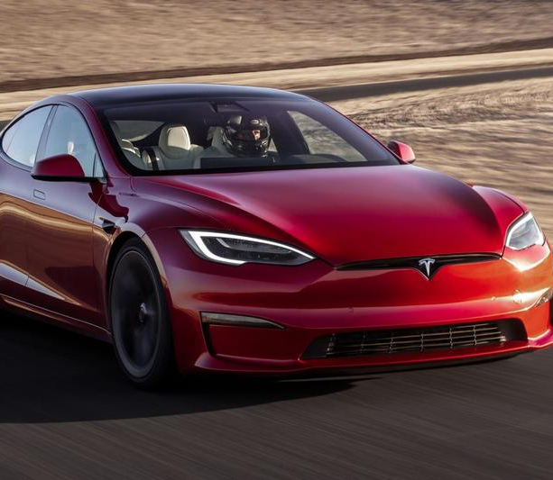
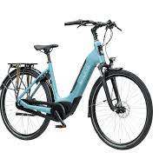



Megatrends
Climate and Energy Crisis
Energy Consumption exploding
Carbon Emission ➔ global warming
Energy Price exploding
Roadmap to carbon neutrality
Electrification of
energy infrastructure

Slide 4
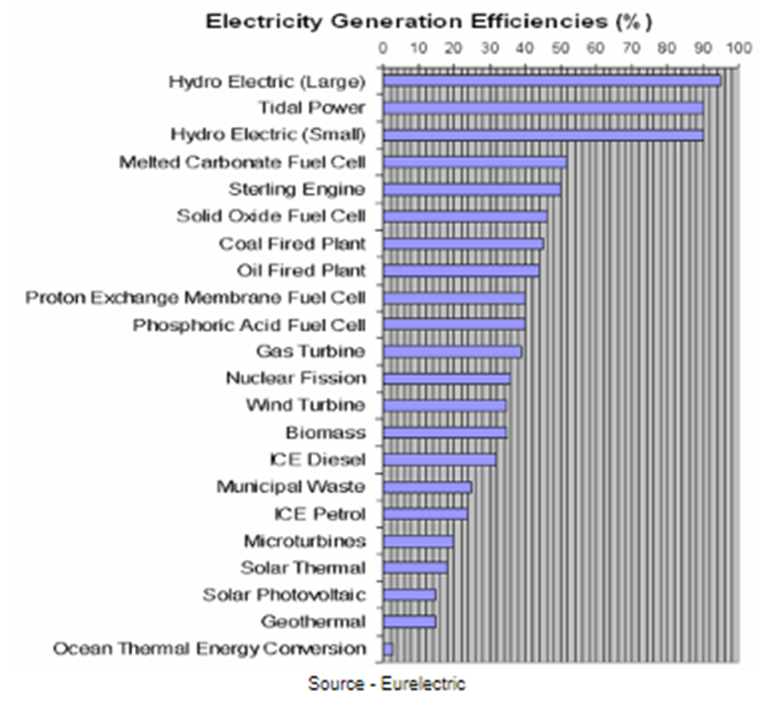
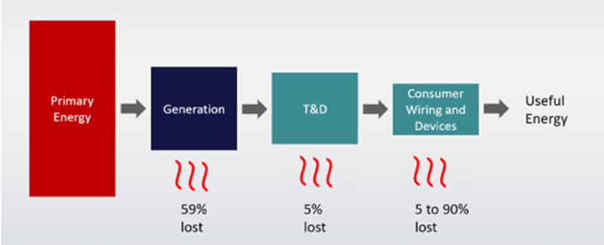
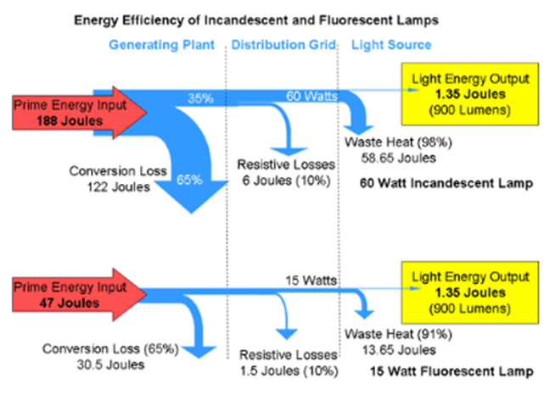
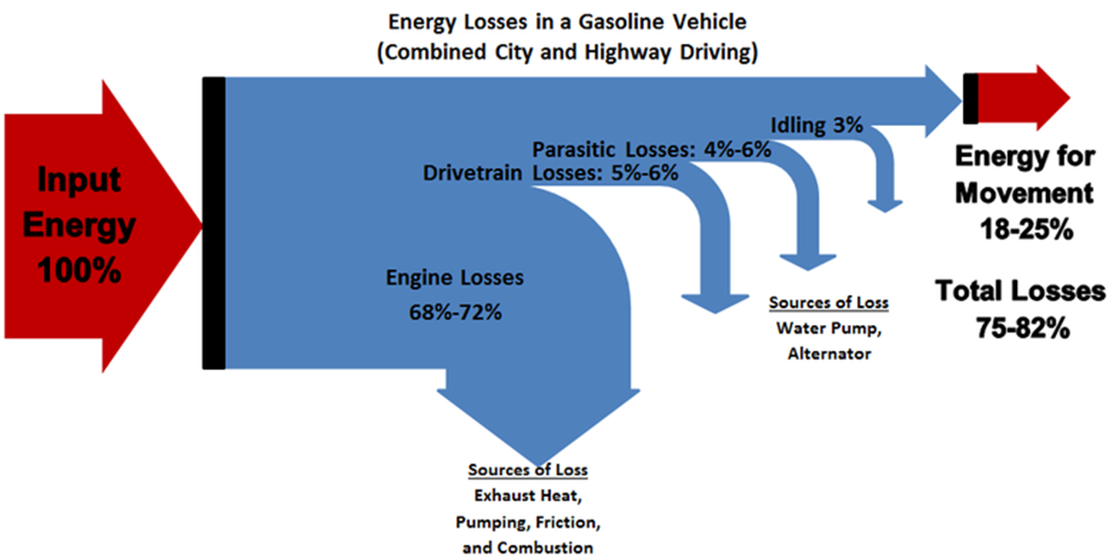
Energy processing is extremely inefficient
Energy Loss (heat) during energy processing:
Loss at Power Plant: (Electricity Generation)
Coal & gas turbines: ~ 60%
Solar PV: ~ 85%
Wind turbines: ~ 65%
Loss at Power Grid
Transmission & Distribution: ~5-10%
US Power Grid (peak load unbalance etc.): ~ 60%
Loss at comsumer premises:
pumps & fans: ~ 40%
eMotors: ~ 5-30%
incandescent light bulb : ~ 90%
LED light bulb: ~ 10%
Need new technology to
process electrical energy
with much higher efficiency
➔ WBG/GaN is the answer !
Car end-to-end energy efficiency
Combustion engine: 18-25%
Electric: 85-90%

Slide 5
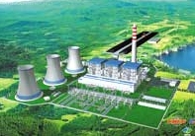
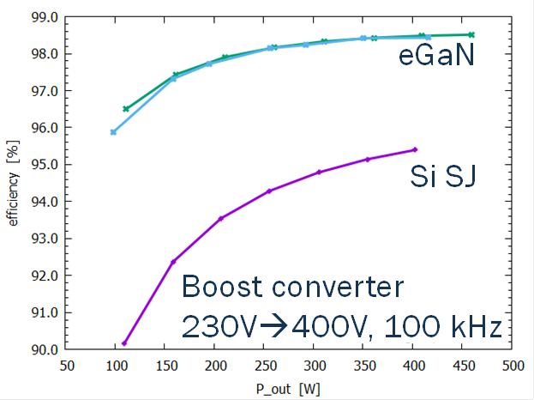





Why GaN? Electrical Energy Efficiency and Carbon Footprint
Power production Plant
Power conversion efficiency (per stage)
4 conversions with 2% loss
100% x 0.98^4 = 92%
1
98%
High voltage grid
150—380 kV
3X reduced
losses
4 conversions with 6% loss
100% x 0.94^4 = 78%
2
94%
Medium grid
50 kV→few kV
GaN brings
14% improved efficiency
3
Transformer hubs/distribution grid
6—20 kV→230V/400V
25% electric energy lost due to conversions (AC/DC, DC/DC, HV/MV/LV)
Global electrical energy consumption (2021) ~ 28500 TWh/yr
Global carbon emission (2021) ~ 37 GtonCO2/yr
14% improvement (25%→11% loss) ~ 4000 TWh/yr ~ 5 GtonCO2/yr
Equivalent to 740 coal-fired power plants
4
POL Adapter
230→12/19V

Slide 6
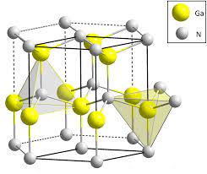
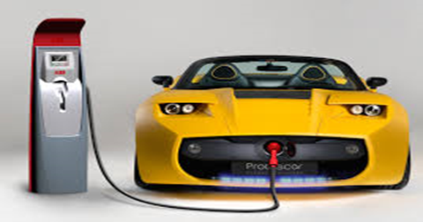
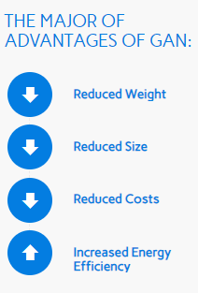
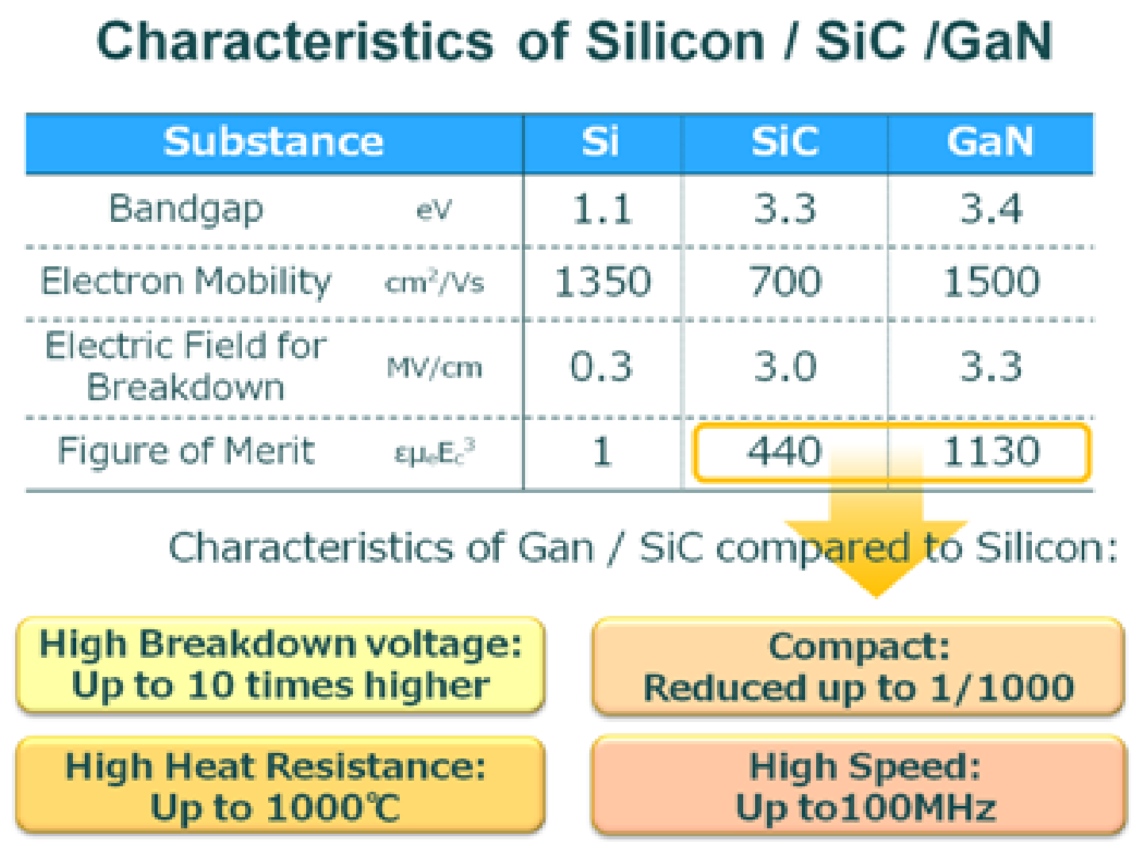

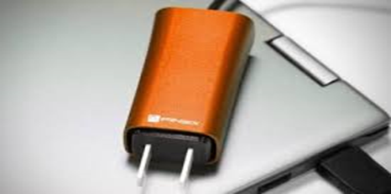
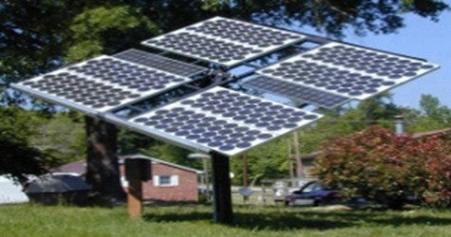
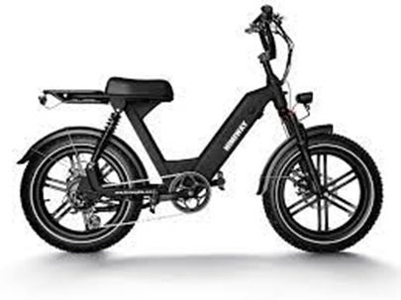
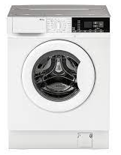

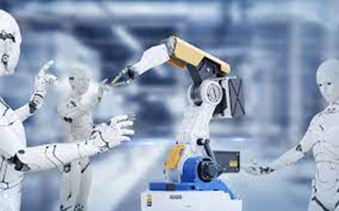
GaN material brings unique properties that enable future Green Energy systems
E-Cars
Major Advantages of GaN for Power System
20% range increase
3X
20% COO
GaN market projected to grow 10X
to >$2B by 2028
Ch 500
2DEG 2000
4X
10X
1000X
Data Centers
(Baliga FOM)
Fast Chargers
50% smaller
3X faster
E-Motors: Robotics
Drones
Appliances
e-Bikes etc.
Solar / Wind

Slide 7
OUTLINE
Setting the stage ➔ GaN bringing a paradigm shift in power electronics
BelGaN intro ➔ A new Open Foundry for WBG semiconductors in Europe
BelGaN Innovation Factory ➔ Bring leading WBG innovation to market
GaN-ValleyTM ➔ BelGaN launches GaN-ValleyTM membership program

Slide 8

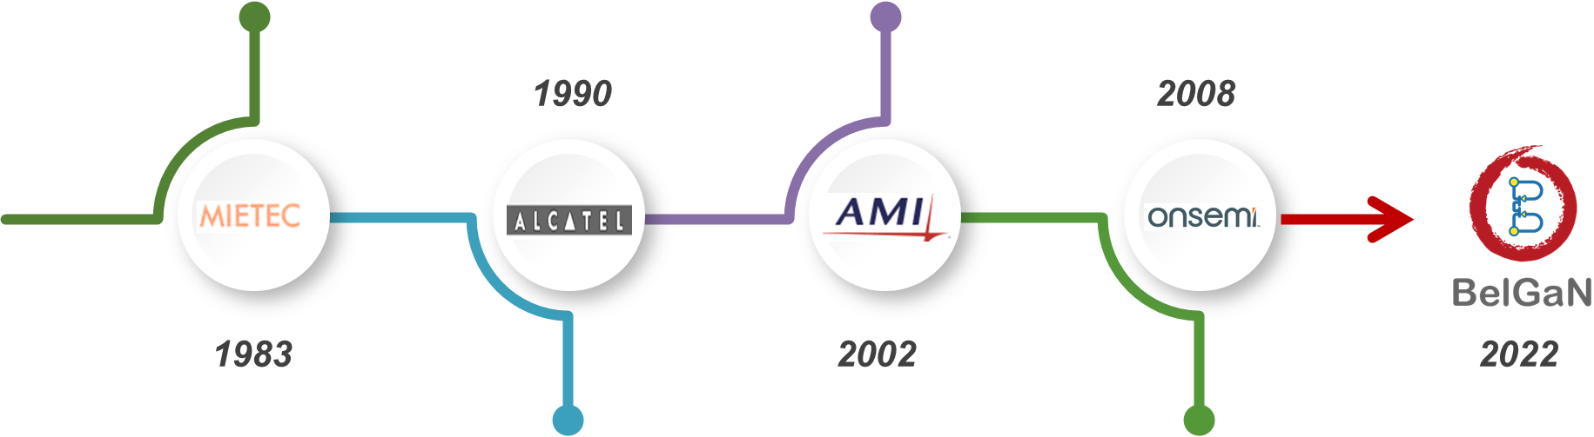
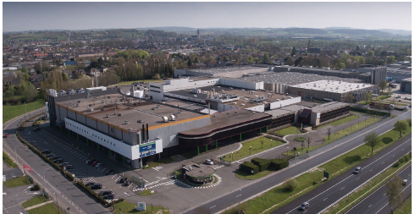
BelGaN is Innovating and Producing WBG chips for a sustainable electrified future
Birth: Feb 8th 2022
A leading Automotive qualified, Open Foundry
in the Wide Band Gap ecosystem, in Europe,
offering differentiated Services

Slide 9
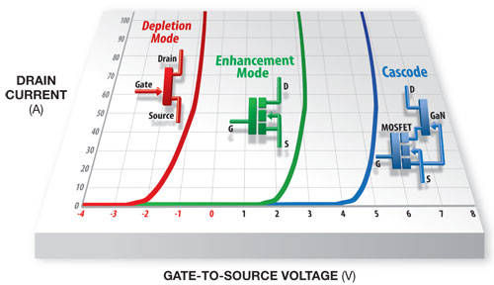
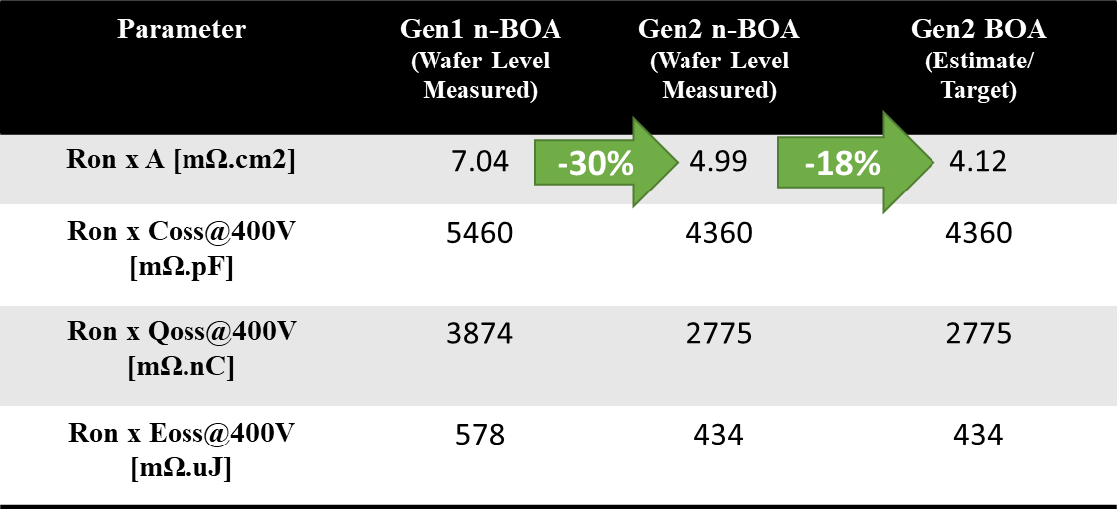
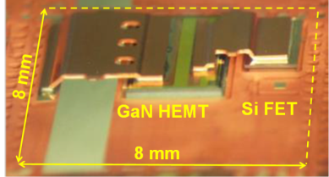
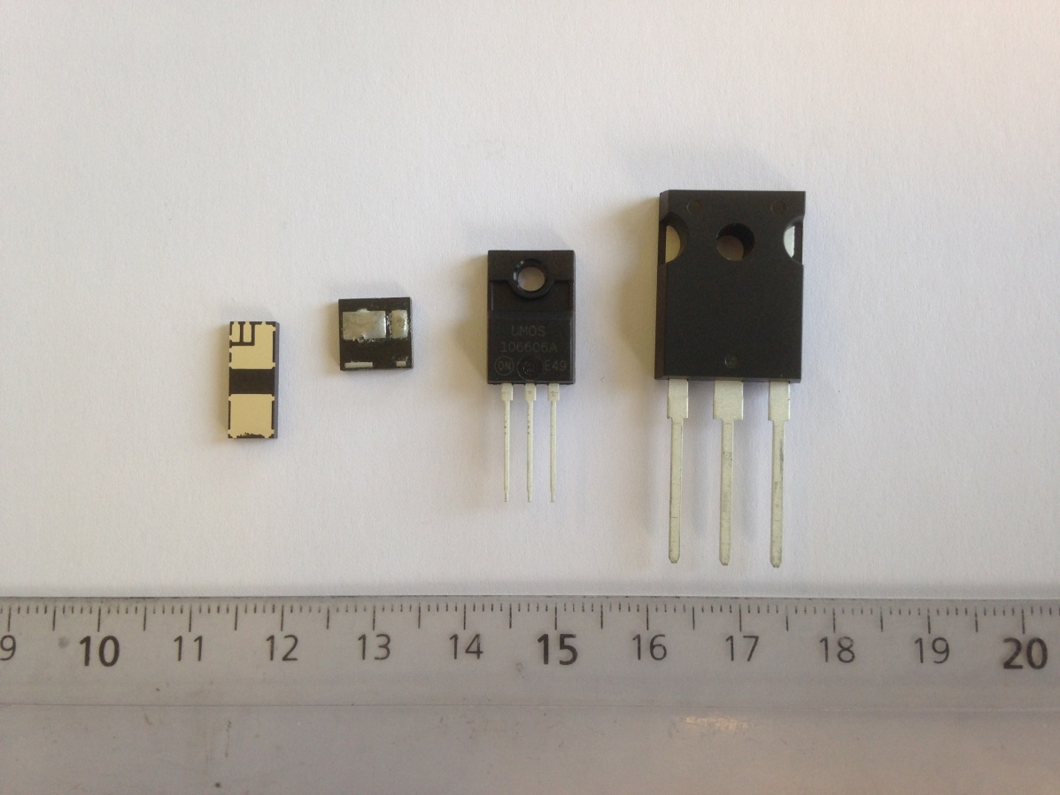
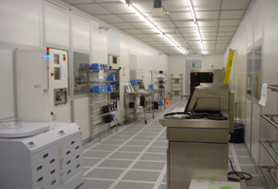
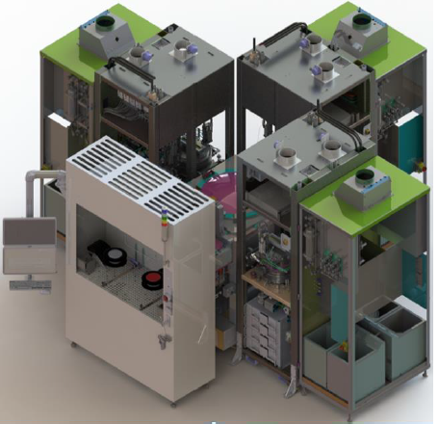
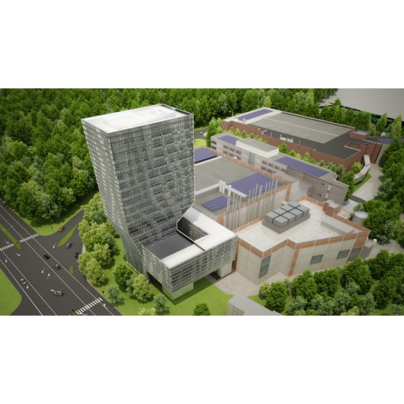

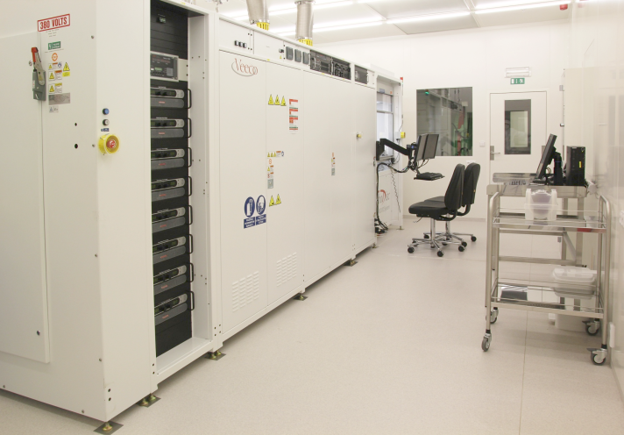


GaN EXPERTISE: >10yr R&D in DHEMT, Cascode, and EHEMT
Dmode (2015)
650V—140mΩ—10A
BelGaN 650V eGaN-1 Platform
! SAMPLING NOW !
production qualification ongoing
Cascode (2016)
650V—50mΩ—30A
GaN
Infrastructure
Emode (2018 – 2020)
650V & 200V pGaN Emode
Fab3
Fab2 - Zone3
-25%
2018: Propel
& Veeco JDP
2012 - 2020: imec GaN IIAP
CZ2

Slide 10
OUTLINE
Setting the stage ➔ GaN bringing a paradigm shift in power electronics
BelGaN intro ➔ A new Open Foundry for WBG semiconductors in Europe
BelGaN Innovation Factory ➔ Bring leading WBG innovation to market
GaN-ValleyTM ➔ BelGaN launches GaN-ValleyTM membership program

Slide 11
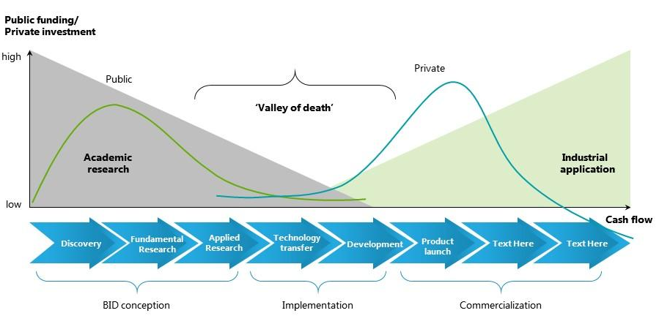

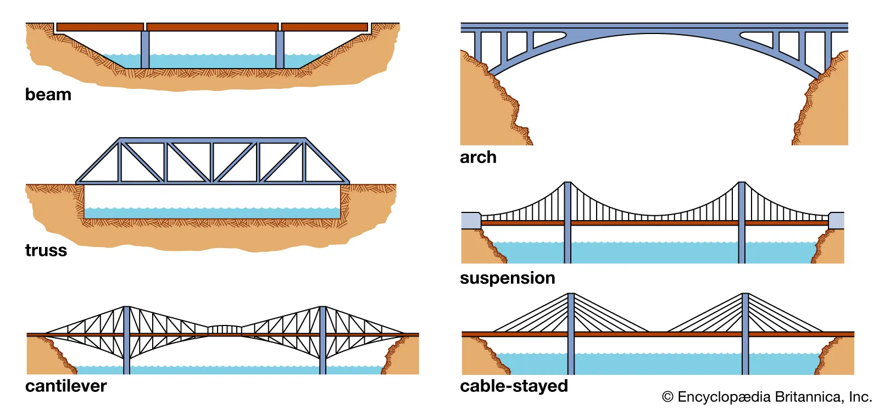
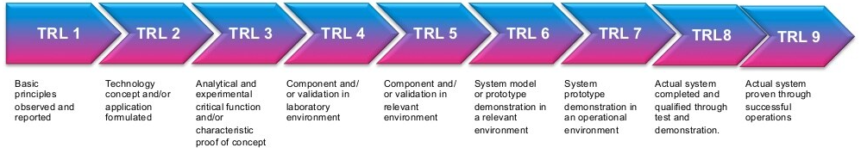
The BelGaN Innovation Factory: from Lab-to-Fab bring leading European GaN research to market by Bridging the Valley-of-Death
Research faculty &
Students
Public Funding
Main Challenges
Knowledge transfer
Collaboration academia-industry
Infrastructure
Funding
Entrepreneurs &
Business community
Private Funding
Bridging the innovation
“Valley-of-Death”
VALLEY-OF-DEATH
BelGaN
Innovation Factory
Cash flow
Valley-of-Death in Manufacturing Innovation Process
Cash flow

Slide 12
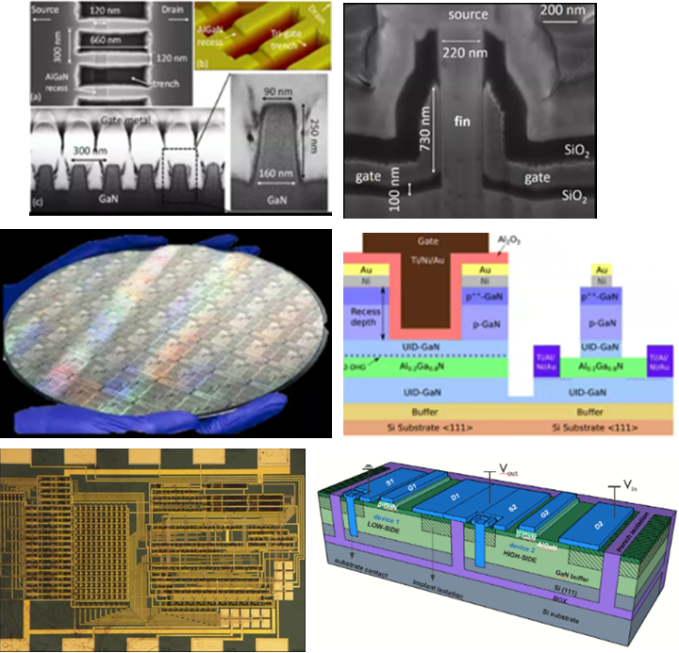

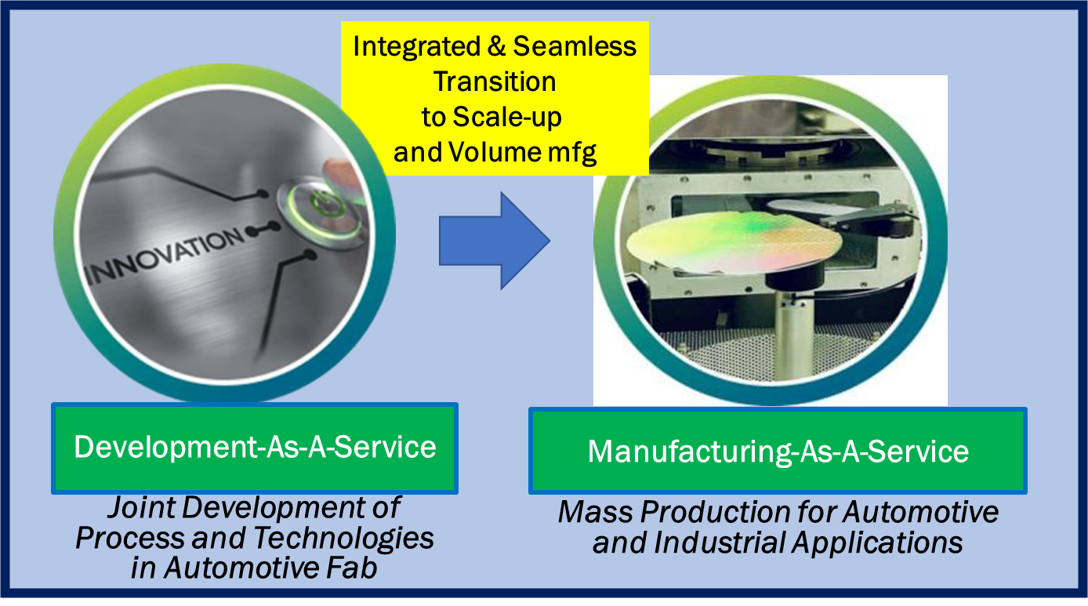
BelGaN Innovation Factory brings Innovation Leadership to Market accelerating Lab-to-Fab and Scale-up the Volume mfg
Concept-Proof in Labs
Industrial Pilotlines and Mfg at Scale in BelGaN
Cash flow

Slide 13
OUTLINE
Setting the stage ➔ GaN bringing a paradigm shift in power electronics
BelGaN intro ➔ A new Open Foundry for WBG semiconductors in Europe
BelGaN Innovation Factory ➔ Bring leading WBG innovation to market
GaN-ValleyTM ➔ BelGaN launches GaN-ValleyTM membership program

Slide 14
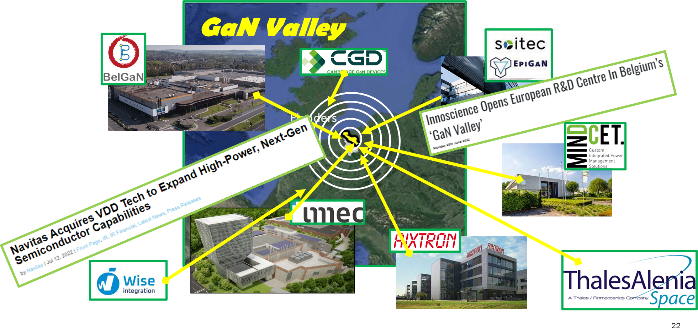

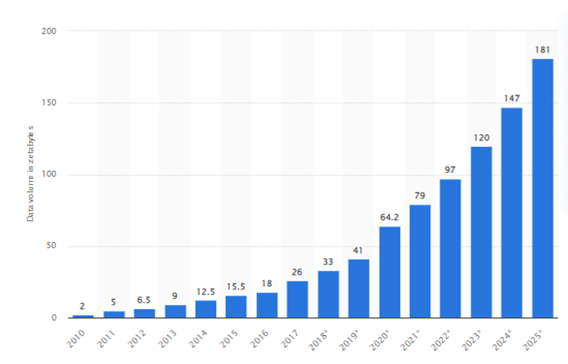
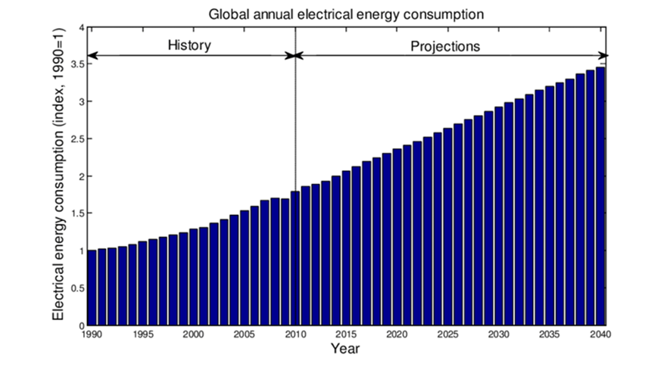
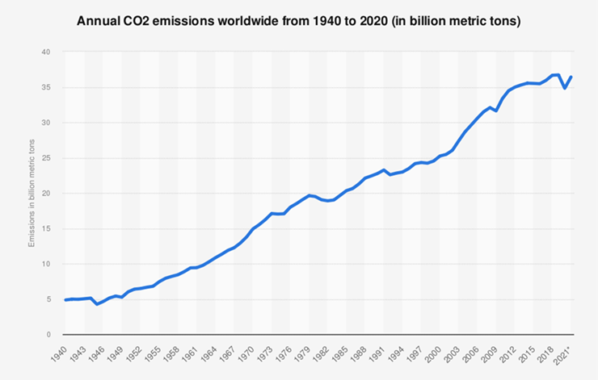
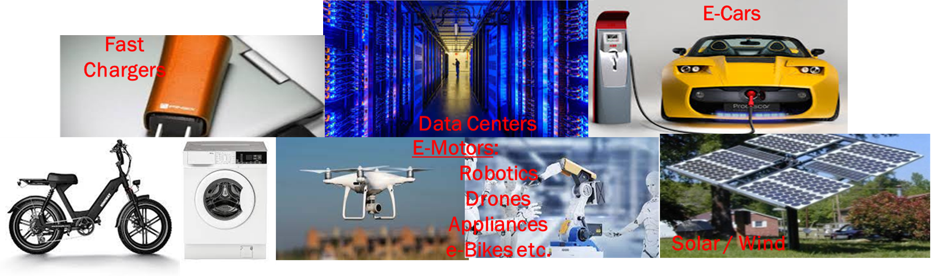
Si-Valley → GaN-Valley
A strongly connected growing Ecosystem
of WBG-Green R&D and industry
A well-connected Ecosystem
of Si and Data R&D and Industry
Si-Valley
Si is a perfect semiconductor for data processing & storage
Si enables cMOS
Moore’s Law – continuous roadmap of scaling, data-processing capacity
Si supports the growing data explosion trend (Zetabytes/yr)
Business Drivers:
Datacom: computers, smart phones & tablets, Internet
IoT
Artificial Intelligence
Autonomous vehicles, …
Societal Mega Trend: Transition to the Digital Society
GaN-Valley
WBG (GaN/SiC) a perfect semiconductor for (electrical) energy processing
Higher energy efficiency (less waste, less cost, faster charging)
Reduced size & weight (scaling)
Reduced system cost
Business Drivers: global electrification
strong growth in electrical consumption (3x over 40yr)
Strong growth in CO2 emission (2X over 40yr) → climate change
Strong increase in electricity price
Societal Mega Trend: Transition to the Green Society
Through Collaboration along the Value Chain
GaN ValleyTM will accelerate Adoption & Scale-up
of a GaN-based industry in Europe
to enable an Electrified Green Future

Slide 15
































GaN ValleyTM membership status ➔ 31 members (April ‘23)
Materials / GaN epi
GaN Components & Systems
Univs & RTOs (low TRL)
Design & Mfg of GaN Chips

Slide 16

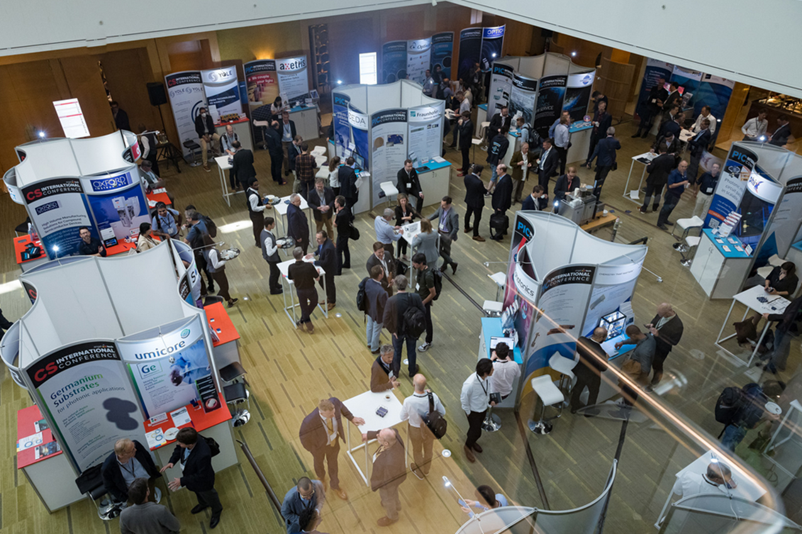

BelGaN launches GaN ValleyTM Membership Program CS International - Brussels April 18-19
^{Thank You}
! ^{Come and see us at our booth !}

Slide 17

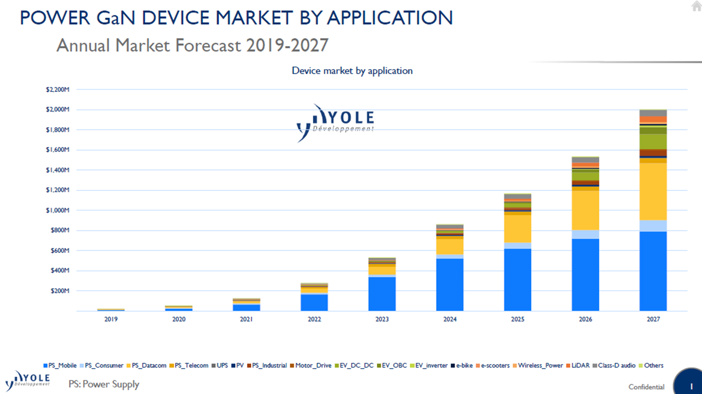
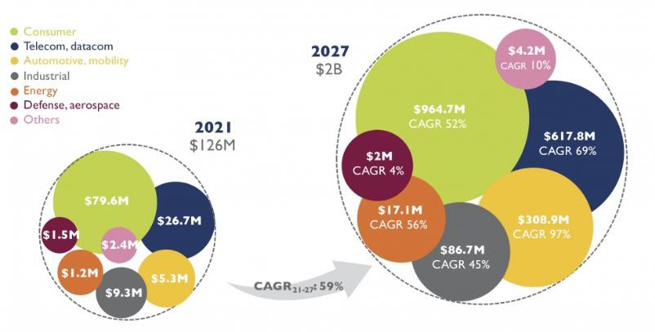
BelGaN Business Opportunity - GaN: TAM forecast by segment
Power GaN market to accelerate from $250M/yr now to over $2B/yr by 2027
Multi-market Business: Power adaptors, Datacom, Industrial and Automotive, etc.
17

Slide 18
GaN ValleyTM Membership Program
VISION: ACCELERATE and SCALE-UP of a GaN-based Industry through COLLABORATION along the value chain.
➔ Informal, for free, organically growing, ecosystem (no legal structure, only NDA) (➔ cfr. Si Valley)
ELIGIBLE MEMBERS:
Research & Industrial organizations in Europe having a core activity or strategic interest in GaN-semiconductors,
along the Value Chain from material research to electronic systems
Engagement
Membership (and logo) announced/used for promotional purposes (GaN ValleyTM map, website, etc.)
Willingness to collaborate with other members, e.g. in consortia programs
Willingness to attend and contribute to GaN ValleyTM initiatives (e.g., virtual or physical workshops)
MEMBERSHIP PROGRAM – objectives@start:
Regular ‘Workshops’ (physical or virtual): technical/business presentations and networking
Training GaN engineers: ‘BelGaN GaN Academy’ and member contributions
Consortia Programs in the frame of European initiatives (ESA, KDT, ChipsAct, ….)
Industry Association promoting GaN
GaN ValleyTM website broadcasting information of all members, technologies/products, etc.

