Slide 1
Plasma Polish
Dry Polish Solution to Prepare Epi-Ready SiC for Power Applications
Amandev Singh Product Manager Oxford Instruments Plasma Technology

Slide 2
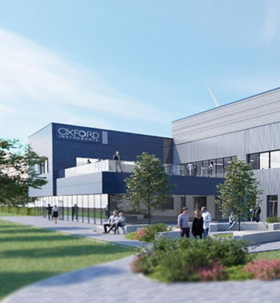
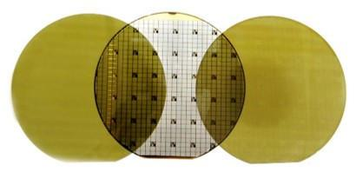
Outline
Company Overview
+
Plasma Polish – A Game Changer
+
Plasma Polish – Customer Value Proposition
+
Program Update and conclusions
+
1

Slide 3
Company Overview

Slide 4


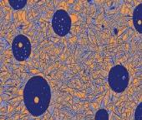

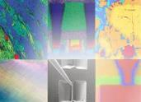
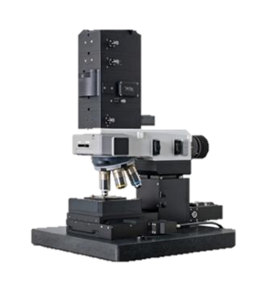
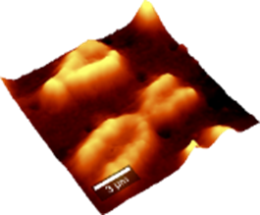
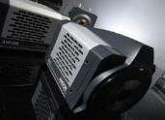



Oxford Instruments Plasma Technology
PLASMA TECHNOLOGY
ASYLUM
MAGNETIC RESONANCE
NANOANALYSIS
8 business units supporting all areas of semiconductor manufacturing and research
WITec
Materials & Characterisation
Products and solutions that enable the fabrication and characterisation of devices down to the atomic scale.
Leader in development & manufacture of Atomic Force Microscopy (AFMs)
Offering a range of benchtop Nuclear Magnetic Resonance (NMR) instruments
Enabling materials characterisation and sample manipulation at the nanometre scale
Leader in d Raman, Atomic Force Microscopy, and Scanning Near-field Optical Microscopy
Leading provider of etch and deposition processing solutions and recipes
ANDOR
NANOSCIENCE
X-RAY TECHNOLOGY
Research & Discovery
Provides advanced solutions that create unique environments and enable imaging and analytical measurements down to molecular and atomic levels.
Development & manufacture of high performance scientific digital cameras and light microscopes
Enabling quantum technologies, nano technology research, advanced materials & nano device development
Leading manufacturer of x-ray tubes, power supplies & integrated x-ray sources
3

Slide 5









Active in all Compound Semiconductors Markets
SiC Power
Quantum
Augmented Realty
3D Sensing
SiC devices enables more efficient power conversion in electric vehicles & renewable energy.
Quantum technology solves complex problems such as traffic flow and enables secure communications
Augmented reality has applications in advan-ced health care and consumer electronics.
3D sensing using GaAs based VCSELs enables autonomous machines, e.g. vehicles.
GaN Power/RF
5G
6G
Datacom
GaN devices for 5G/6G base stations and power efficient consumer electronics.
Next generation InP/ GaAs based lasers and receivers increase optical fibre data bandwidth.
4

Slide 6
Plasma Polish – A Game Changer
Stable, cost effective and green Polish solution
to prepare epi-ready SiC substrate surface

Slide 7
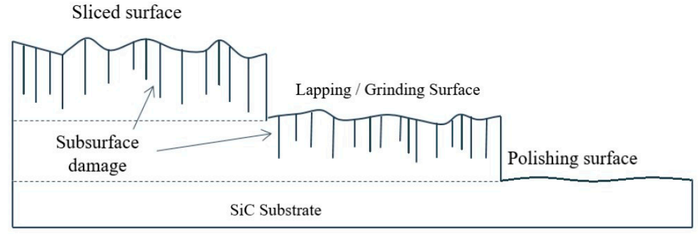
Why Polish ? Need Damage free crystal for Front End Manufacturing
Substrate Manufacturing
Front End Manufacturing
Crystal Growth
Flat for-mation
Slicing
Grinding
Polish
EPI
Etch
Deposition
Other
Grind
Why Polish: To get good crystal surface to grow Epi.
No sub-surface damage or contaminants.
Means: Remove all defective material /nano-particles left by slicing/ grinding
In Practice: CMP by design only targets surface/roughness.
Polish
Hsieh, C.-H.; Chang, C.-Y.; Hsiao, Y.-K.; Chen, C.-C.A.; Tu, C.-C.; Kuo, H.-C. Recent Advances In Silicon Carbide Chemical Mechanical Polishing Technologies. Micromachines 2022, 13, 1752.
6

Slide 8
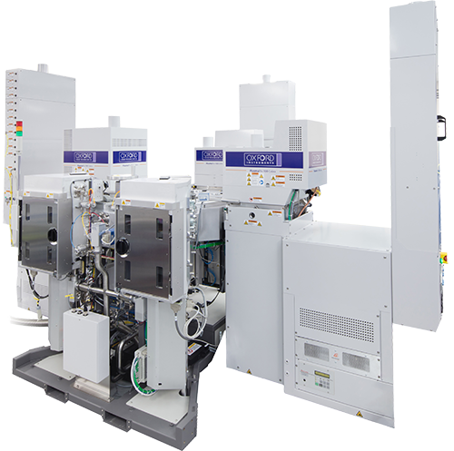
Plasma Polish
An etch process to provide epi-ready surface in SiC substrate production
Proprietary process (patent pending)
Based on proven PlasmaPro 100 Cobra single wafer etch system with modified hardware
Crystal growth
Slicing and grinding
Plasma Polish
EPI
Device
smooth / epi-ready surface
free of subsurface damage
reliable and consistent surface quality
low operating cost
clean process (standard process gas / abatement)
proven with SiC pin-Diodes and MOSFETs
PlasmaPro 100 Cobra single wafer etch system
7

Slide 9

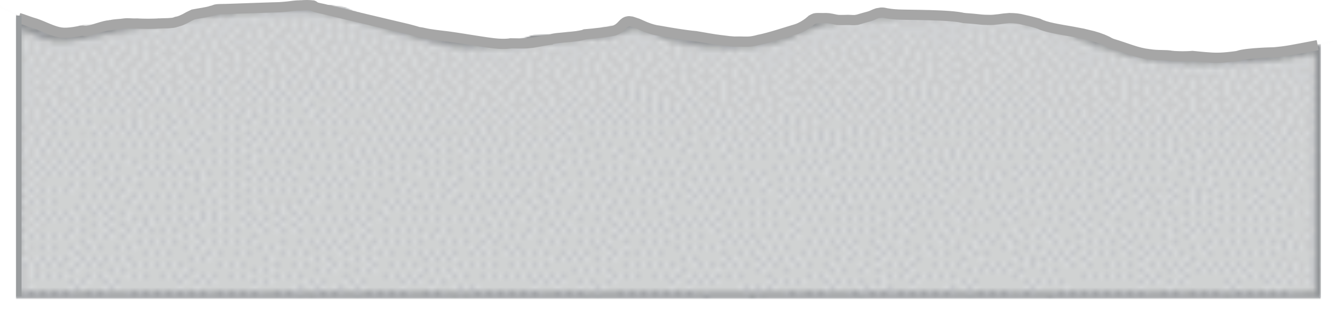
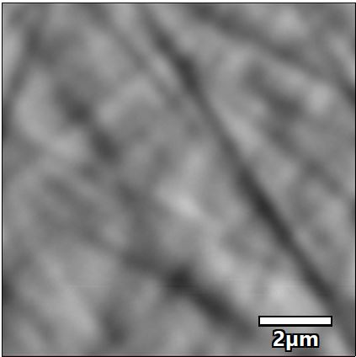

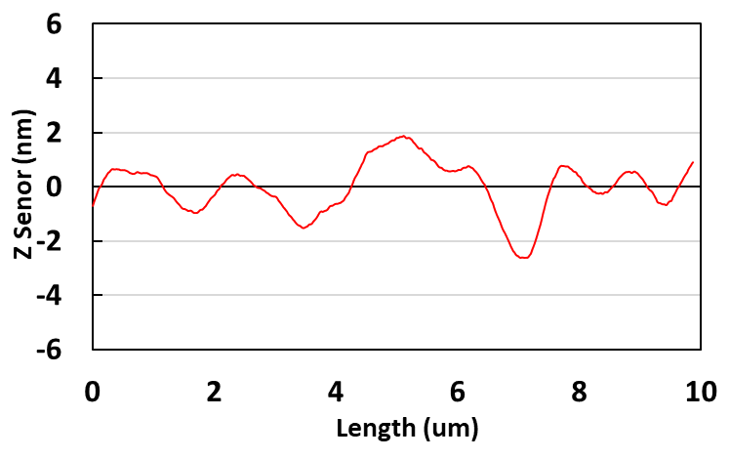
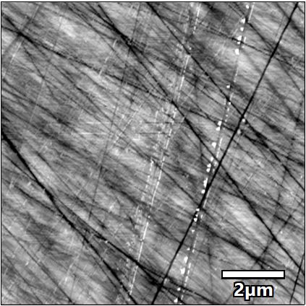


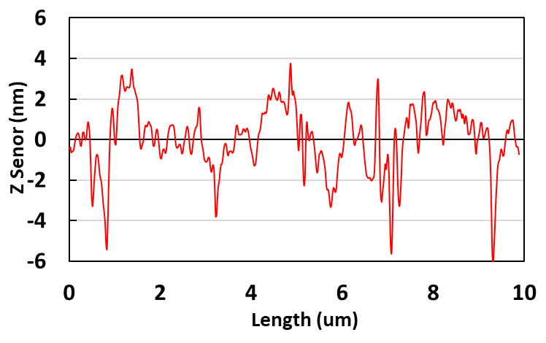
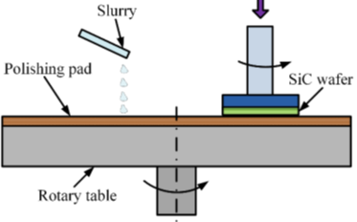
How the process works: Surface-level concept Plasma Polish is an etch process directly targeting subsurface damage
Subsurface Damage: Dense Network of Narrow Scratches and defects induced by grinding.
Plasma Polish
Preferential etching of damaged area.
Effectively leaving behind good crystal structure and approx. 50% R_{a} reduction.
Subsurface damage free surface with some leftover waviness
Fine Grinding
10x10µm²
R_{a} (nm) – 0.70
10x10µm²
CMP
Removing Top Surface Sequentially.
Chemical and Mechanical actions to achieve high flat-ness.
Highly flat surface with a likely-hood of observing leftover subsurface damage
R_{a} (nm) – 1.50
8

Slide 10
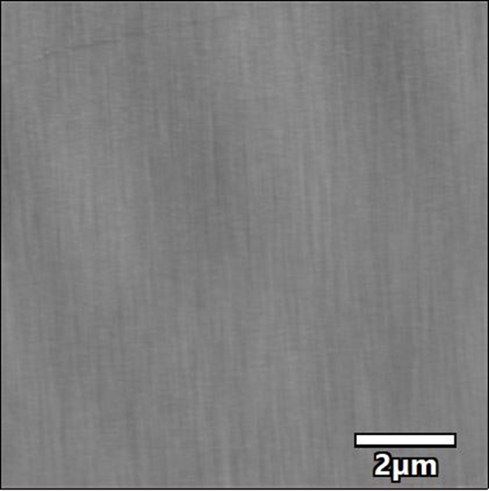
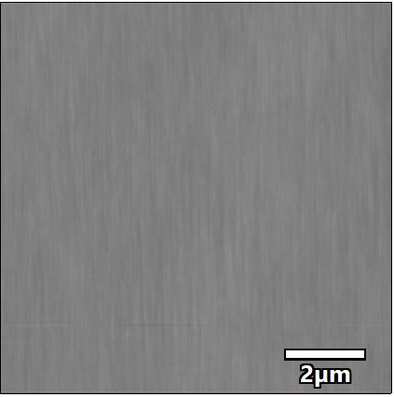
Process Validation: Epi-Growth
Post Epi Roughness of Plasma Polish wafers comparable to benchmark CMP reference processed using same recipe.
Plasma Polish - Oxford Instruments
CMP Reference
Plasma Polish
After deposition
After deposition
MOCVD Growth
Standard recipe (10um Dep)
80% Ra Reduction.
R_{a} (nm) – 0.70
R_{a} (nm) – 0.14
R_{a} (nm) – 0.12
9

Slide 11
Device Validation – MPD & MOSFETs
Plasma Polish & CMP Substrates (Wolfspeed)
SiC Epi growth
Optical/PL Inspection
MPD/MOSFETS
150mm Wafers - Wolfspeed
Plasma Polish ↔ Chemical and Mechanical Polish (CMP)
Merged pin Diodes (MPD) operating at 1200V and 10 A and dies area of 2.4x2.4mm²
Comparison between 2 CMP and 2 Plasma Polish wafers
MOSFETS operating at 80mΩ, 1200V and a dies area of 2.83x2.83 mm²
Comparison between 3 CMP wafers and 3 Plasma Polish wafers
10

Slide 12
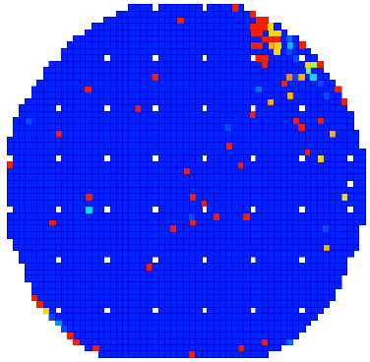
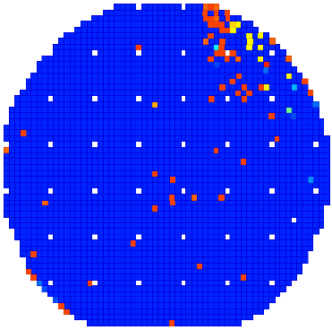
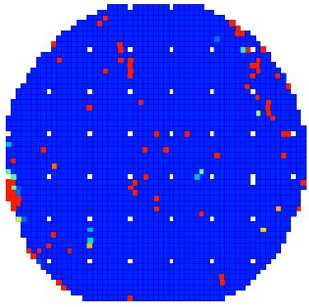
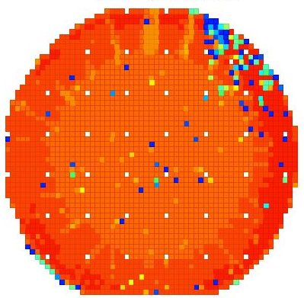
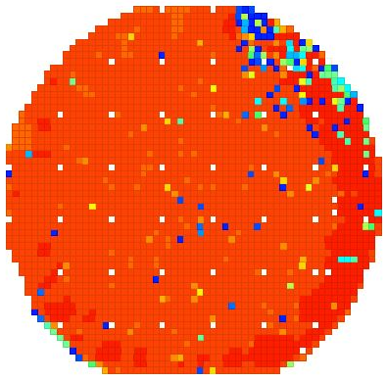
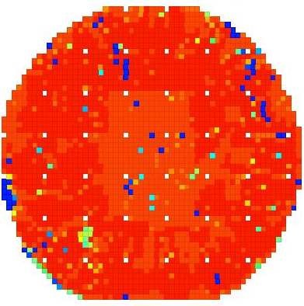
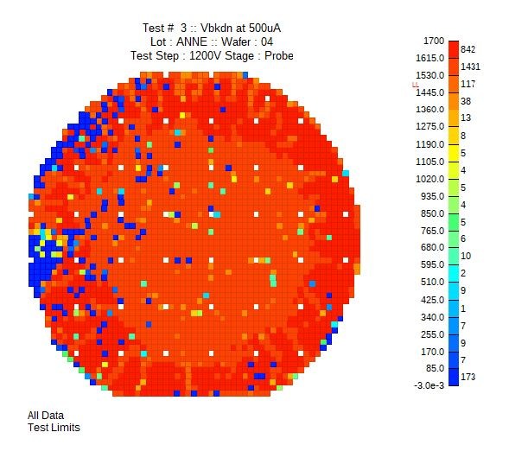
Device Validation – Merged pin Diodes Yields
Sub-surface damage and it’s yield impact observed in a production grade substrate supplied by a leading supplier
Plasma Polish
CMP REFERENCE
J_{R} at 600V
(J_{R} < 1.7E-6 A/cm²)
Sub-surface damage remains after CMP revealed at epi (not seen prior)
97% Dies passed
97% Dies passed
97% Dies passed
91% Dies passed
V_{B} at 500µA
(V_{B}>1500V)
92% Dies passed
93% Dies passed
94% Dies passed
89% Dies passed
11

Slide 13
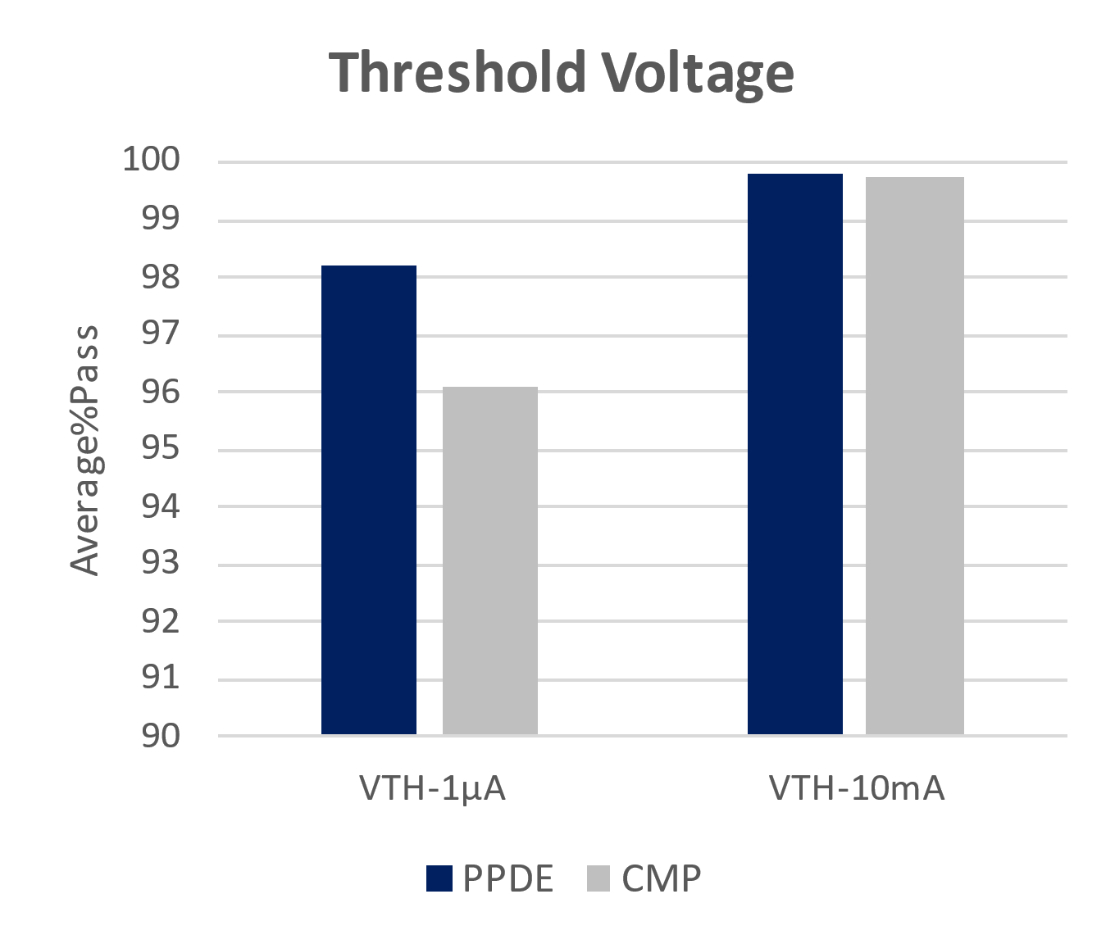
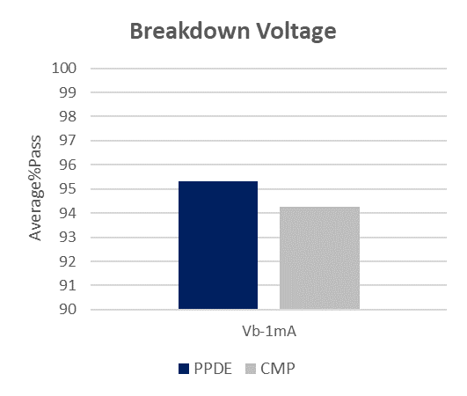
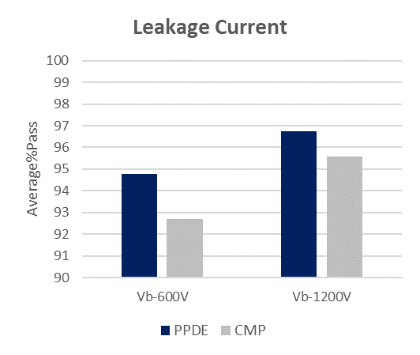
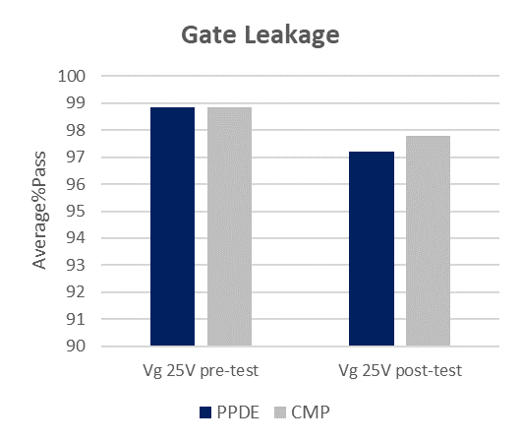
Device Validation – MOSFETs Yields
Average Pass rates/ Good Devices, (%)
3 Plasma Polish wafers ↔ 3 CMP wafers
MOSFETs operating at 1200V
Plots reporting the average of the % of dies passed/wafer
MOSFETs on Plasma Polish substrates perform at same level as MOSFETs on CMP substrates
12

Slide 14
Plasma Polish – Value Proposition
Cost reduction
Potential Yield improvement
Environment friendly

Slide 15




Benefits of the Plasma Polish process
Crystal growth
Slicing and grin-ding
CMP
EPI
Device manufac-turing
USD 23/wf
(direct cost savings)
Plasma Polish
Cost reduction for 150 mm substrates, plus additional USD 50-70/wf cost potential through thinner slicing¹
Oxford Instruments Plasma Polish as alternative to CMP process
Reduction of operating costs by USD 27/wafer
High process and results stability through replacement of mecha-nical processing
USD 45/wf
(direct cost savings)
Cost reduction for 200 mm substrates
Enabler for thinner wafer slicing to increase absolute numbers of wafer/boule and reduce costs
USD 12-15/wf
(potential cost savings)
Minimization of the utilization of toxic materials
Cost reduction for front-end manufacturers for each pp line yield improvement²
PlasmaPro 100 Cobra single wafer etch system
1. Based on average substrate costs of USD 1200/6″ wafer and 24 USD/6″ wafer savings in plasma polishing operating costs 2. Based on ~ USD 500-600/wafer for FE manufacturing
14

Slide 16
Program Update and Conclusions

Slide 17
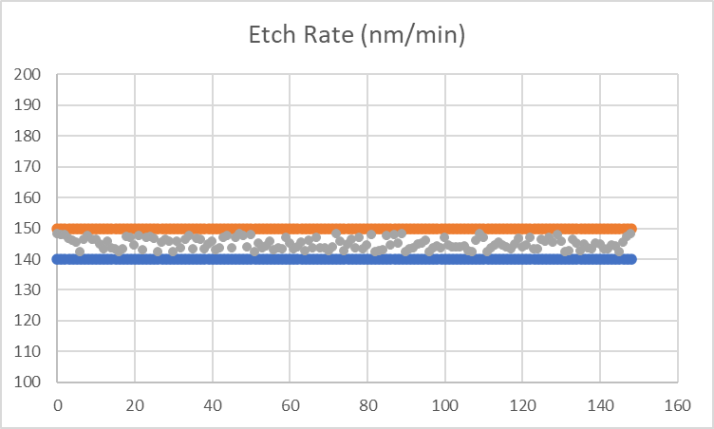
Program Update
Program Inception (2020)
Market Launch (ICSCRM 2022)
Current Status
Asia
EMEA
USA
Post Launch
Post Market Launch Engagements
Substrates from 5 SiC customers/ partners.
Over 150 stable full wafer process runs.
Demonstrated Tool-to-Tool process transfer.
Over 20 Additional active customer engagements
Exploratory joint programs to expand use-cases
16

Slide 18
Conclusions
Oxford Instruments is the recognized partner for Plasma Technology for CS Industry
Trusted partner in RnD and High-Volume Manufacturing.
Established production platform supporting key processes in CS Market.
Continuously investing in new process technology for power Applications.
Active programs in SiC as well as GaN to support Power Semiconductors.
Plasma Polish: A powerful polishing solution for SiC substrate manufacturing
Validated using industry standard MOSFET and MPD devices.
Significantly Lower Cost compared to current polishing solutions.
Offering high stability and process capability (proven independent of substrates vendors).
Environmentally friendly process, with significantly higher ease of use.
Expanding program: Active engagement with key SiC PE customers.
17

